Slide 1
Electronic Commerce
Introduction
Lecture 1
Byung Joon Yoo

Slide 2
About Instructor
SNU B.S. in Business (90)
KICPA & Accountant at KPMG and at Korean Army
U of Arizona MS in IS
Carnegie Mellon University, Ph.D. in Business (IS major)
Clean Site Selection Committee (By Copyright Protection Center)
Current Research Topics-Anything to Analyze with Quantitative Methodologies
  IT Productivity: KRX (How to measure?)
  Online & Mobile Games: Impact of Real Money Trading on Games themselves, Monetary management in Cyberworld, Industrial Policy & Regulation Issues
  Digital Contents: Online Music Rankings, Bundling, Apple App Store Pricing Strategy

Slide 3
Why IS Mgt Difficult?
Interdependence of Information Systems (From Laudon & Laudon)
Technology
Organization Management
IS

Slide 4
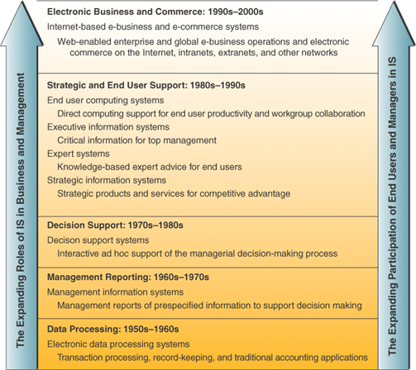
Trends in Information Systems
Notes:
Note that while IS has expanded, they are still doing the same basic things that they’ve been doing.
What has changed is: more integration of functions, greater connectivity across components, better use for maximum advantage of business and strategic opportunities

Slide 5

Strategic IT?
Abacus
ENIAC (1946)
DSS (1970-80s)
Expert Systems (8-90s)
Ecommerce (9-2000s)(Million Words)
Big Data, SNS (2010s) – Now we can say.. (Trillion Words)

Slide 6
The Objective of This Class
How to analyze phenomena in Electronic Commerce
  Digital Products (Online Game, Music – no material) related Strategies and Policies
  New Business Models
  Strategic Use of EC Channels for existing offline firms
Methodology: Theories which can be applied w. Your Brilliant Idea

Slide 7
Admin. Stuffs (Continued)
Grading: Details in Syllabus
  Participation 10% (attendance & participation in discussion)
  Final Exam 30% (Open book questions on analysis)
  Case Summary & Team presentation 60%
Textbook: 전자상거래 by Laudon & Traver (김범수 외 역), 시그마프레스

Slide 8
Chapter 1. The Information Economy
Carl Shapiro
Hal R. Varian

Slide 9
Information
Anything that can be digitized
  Text, images, videos, music, etc.
  a.k.a. content, digital goods
Unique cost characteristics
Unique demand characteristics

Slide 10
Unique Cost structure
Expensive to produce, cheap to reproduce
High fixed cost, low marginal cost
  Not only fixed, but sunk
  No significant capacity constraints
  Lower quality may be more expensive!
Leads to value based pricing (Not material based, mark-up pricing)

Slide 11
Complementary products
Complements
  Hardware/software, Client/server, Viewer/content
  Different manufacturers
  Strategy for complementors as well as competitors
  Compatibility as strategic choice
  Standards and interconnection

Slide 12
Rights Management
Low reproduction cost is two-edged sword
  Cheap for owners (high profit margin)
  But also cheap for copiers
Maximize value of Intellectual Property, not protection
Example: Video industry

Slide 13
Consumption Characteristics
Experience good
  Browsing
  Reputation and brand identity
Overload
  Economics of attention (Herbert Simon (Deep Blue 1997 (CMU Students) from his prediction in 1957))
  Hotmail example (One-to-One)
  Broadcast, point-to-point, hybrid

Slide 14
Technology
Infrastructure to store, retrieve, filter, manipulate, view, transmit, and receive information
Adds value to information
  Web = 1 terabyte of text = 1 million books
  If 10% useful = 1 Borders Bookstore
  Value of Web is in ease of access (manipulation)
    Front end to databases, etc.

Slide 15
Systems Competition
Microsoft-Intel: Wintel
  Intel
    Commoditize complementory chipset, motherboard (CPU at the center)
  Microsoft
    Commoditize PCs (w. major PC makers)
Apple
  Integrated solution
  Worked better, but lack of competition and scale led to current problems

Slide 16
Lock-In and Switching Costs
Example: Stereos and LPs
  Costly switch to CDs
Systems lock-in: durable complements
  Hardware, software, and wetware
  Individual, organizational, and societal

Slide 17
Network Effects
Value depends on number of users
Positive feedback
  Fax (patented in 1843)-1980, Critical Mass
  Internet (1980s)-From 89, From 95 Privatization
Indirect network effects
  Software
Expectations management – Before CM
  Competitive pre-announcements

Slide 18
Compatibility
Examples
  Beta v. VHS
  Sony v. Philips for DVD
    CD Technology
Backwards compatibility?
  Windows, MS DOS Yes
  Nintendo64 No

Slide 19
Basic Strategies
Go it alone
Partnerships (Java)
Formal standard setting
  Widespread use
  Licensing requirements
Competition in a market (standard) or for a market (alone)?

Slide 20
Policy
Understand environment
Competition policy
  Regulation – MS M&A
  Antitrust – The Sherman Act 1890 Already
Electronic commerce
  Contracts
  Privacy

Slide 21
Information is Different… but not so different
Sometimes new things come up (Long tails)
  A usual BN book store has about 130,000 titles in the store. But more than half of Amazon’s sales is outside its top 130,000 titles.
  Information and its advanced technology made the Long tail story possible.
Still traditional wisdom works
  Netscape vs. MS Explorer (Interconnection)
  EC hypes in era I (1995-2000)
  Do not refer to fancy hypes, but to science (Especially, Powerful in long term race)
Key concepts
  Versioning, Lock-in, Systems competition, Network effects

Slide 22
Approach by Varian & Shapiro
Trends vs. Model – Forcast by extrapolation vs. by economic principles
Vocabulary vs. Concept – Buzzword for voca purpose vs. New terms if useful
Analogies vs. Analysis – Good for communication but may mislead

Slide 23
Next Session
Chapter 2 Pricing
Team Assignment + Case Assignment

